Slide 1







PREDICTIVE ANALYTICS FOR GOOGLE PLAY STORE REVIEWS AND RATINGS
Damo 510 - 3
Prof. Zeeshan Ahmad
Group 10:
Heta Chavda (NF1014555)
Tapan Mewada (NF1009571)
Neel Vadadariya (NF1010276)
Nadeem Basha Syed (NF1013767)

Slide 2

Introduction
Data Collection & Preprocessing
Exploratory Data Analysis (EDA)
Machine Learning Models Used
Key Insights from Analysis
Future Predictions & Business Insights
Conclusion & Future Scope
Team Experience & Learnings
Q&A
Agenda

Slide 3



INTRODUCTION
Google Play Store Market Overview
The Google Play Store hosts millions of apps, making it a highly competitive marketplace.
With billions of downloads yearly, user feedback is crucial for app success.
Importance of Predictive Analytics in this Domain
Helps forecast trends and improve decision-making.
Identifies factors that contribute to app success.
Optimizes app features and enhances user satisfaction.
Objectives:
Predict app ratings.
Analyze user sentiments in reviews.
Identify key factors influencing app ratings
Compare Free vs Paid Apps
Forecast future app market trends
provide business insights & strategic recommendations

Slide 4




Data Collection & Preprocessing
Datasets Used:
Google Play Store Apps Dataset
Google Play Store User Reviews Dataset
Preprocessing Steps:
Handling missing values
Encoding categorical variables
Converting numerical columns
Merging datasets
Resource
Keggle website

Slide 5

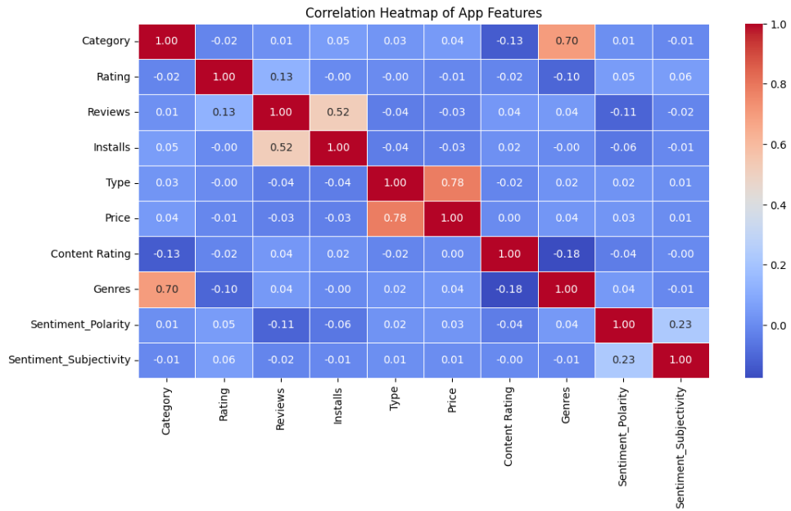

Exploratory Data Analysis (EDA)
Heatmap:
This correlation heatmap visualizes the relationships between different app features from the Google Play Store dataset. Notable correlations include a strong positive relationship between Price and Type (0.78) and between Genres and Category (0.70), while most other features show weak or negligible correlations.
Your sentiment analysis shows that positive reviews dominate, indicating a largely favorable user experience, while negative reviews outnumber neutral ones, suggesting that dissatisfied users tend to express stronger opinions.
Aim: What factors contribute most to an app’s high rating or user satisficaiton ?
Moderate : Reviews & Installs
High Correlation : Price & Type
Significant Correlation : Genres and Category
Rating Correlation: Rating show a weak correaltion with most individual features

Slide 6
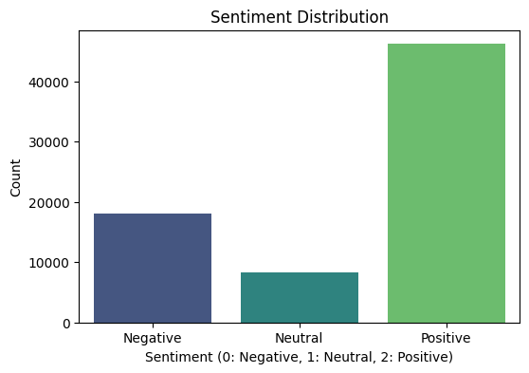
Classification Model
Aim: Based on sentiment analysis, can we determine whether an app’s reviews are positive, neutral, or negative?
Model used: Random forest classifier
Features: Reviews, Installs, Price,Category, Content rating, Genres
Purpose: Predict wheather
Positive Sentiment: Majority reviews
Negative : Significant portion of reviews
Neutral: Fewer reviews

Slide 7
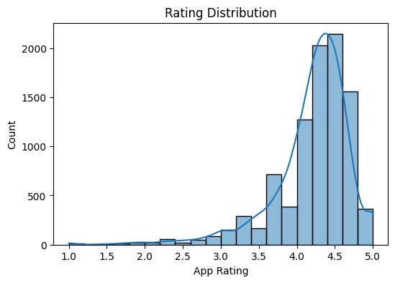
Clustering Model
Aim: : How are app ratings distributed across the dataset, and what insights can we derive from user feedback?
Model used: K-means Clustering
Features: Group apps into diffrent rating clusters (low, medium, high)
Majority ratings: 4.0 to 4.7
Very few ratings: below 3.0
Sight left skew : low ratings

Slide 8
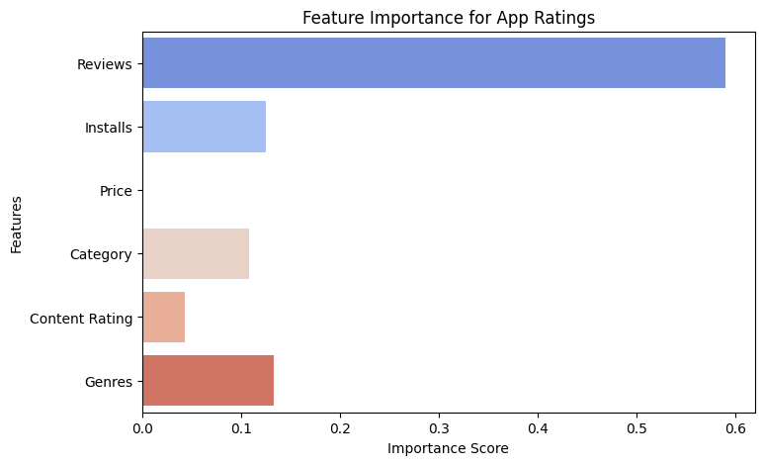
Random Forest Regressor
Aim: What factors contribute most to an app’s high rating or user satisfaction?
Model used: Random forest
Features: Predicting Apps rating
Reviews have the highest impact on ratings
Installs and Genres also play a significant role
Price and Content Rating have a lower impact

Slide 9
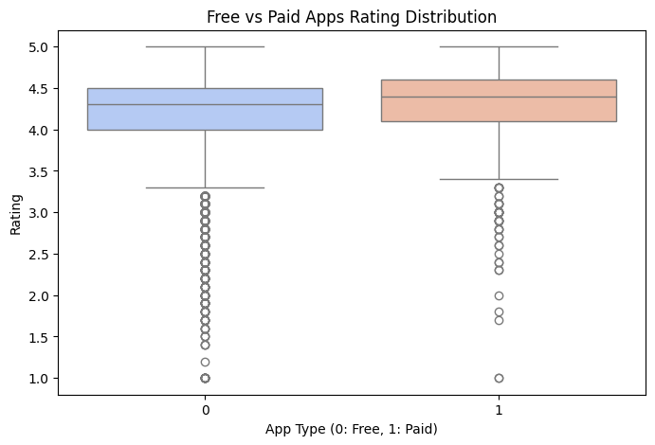
Classification Model
Aim: How do ratings differ between free and paid apps, and what can be inferred from this comparison?
Model used: Logistic Regression
Features: Predicting Apps rating based on features
Paid apps generally have slightly higher ratings compared to free apps
Free apps have a wider range of ratings, with some apps scoring very low
Outliers in free apps suggest that some free apps receive extremely low ratings

Slide 10
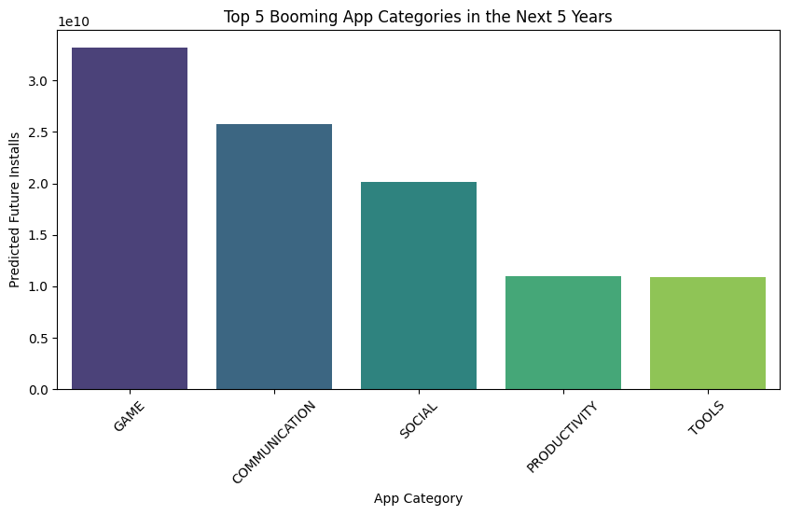
Time series model
Aim: On the basis of the demand of the application and the new technology, we make a model to predict which app category will be booming in the next 5 years.
Model used: ARIMA
Autoregressive Integrated Moving Average
Features: Best for short term forecasting
This analysis provides valuable insights for developers, investors, and businesses looking to capitalize on emerging app trends. The rising demand in these categories suggests a promising opportunity for innovation and market expansion.

Slide 11

Business Insights
Now, time to upload on Google playstore
More installs & positive reviews = Higher ratings.
Free apps get better sentiment ratings than paid ones.
Some categories have stronger positive sentiment than others.
Price matters, but user experience & reviews matter more.
App popularity depends on multiple factors, not just quality.
Trends from data help businesses plan for future growth.

Slide 12
Conclusion & Future Scope
Summary of Findings:
Predictive models help developers understand user behavior
Ratings and reviews are critical indicators of success
Future Enhancements:
Integrating deep learning for better sentiment analysis
NLP-based review understanding
Time-based sentiment tracking

Slide 13
Team Experience & Learnings
Importance of Predictive Analytics:
Helps businesses make data-driven decisions
Useful for optimizing app features and engagement strategies
Key Takeaways:
Data quality and feature selection are crucial for accurate predictions
Insights can drive future app improvements

Slide 14



THANK YOU & Q&A
Thank you for your time!
Any questions?

Slide 15
REMEBER , THE FUTURE OF DATA ANALYTICS IS YOU !

